Slide 1

Quoi Son Primary School
Welcome to our class!
Teacher: Tran Thuy Trang

Slide 2
Lucky numbers

Slide 3

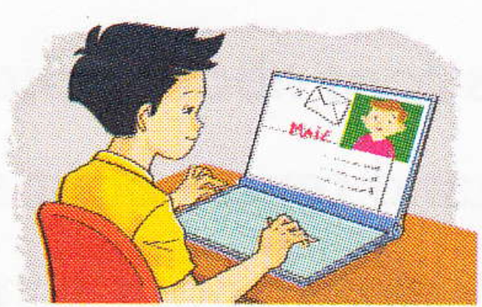
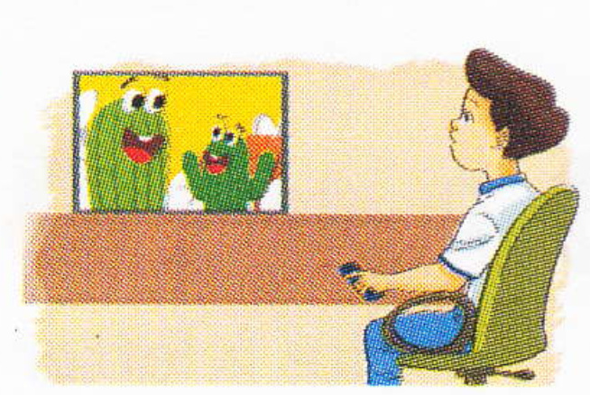

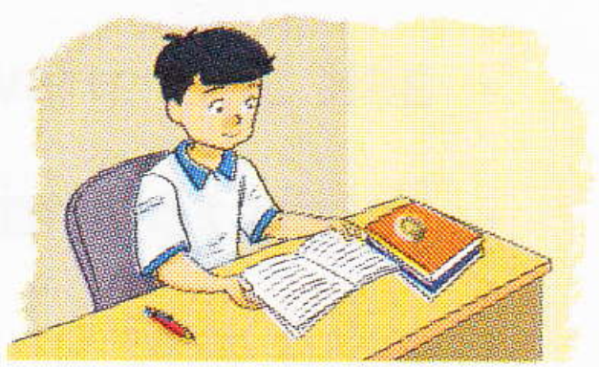
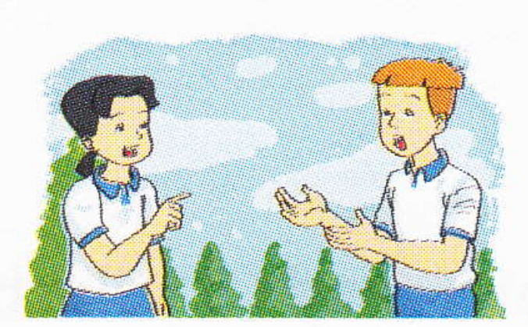
Lucky numbers
How do you practise............? -> I...............
1
2
3
listen
write
4
5
6
read
speak

Slide 4
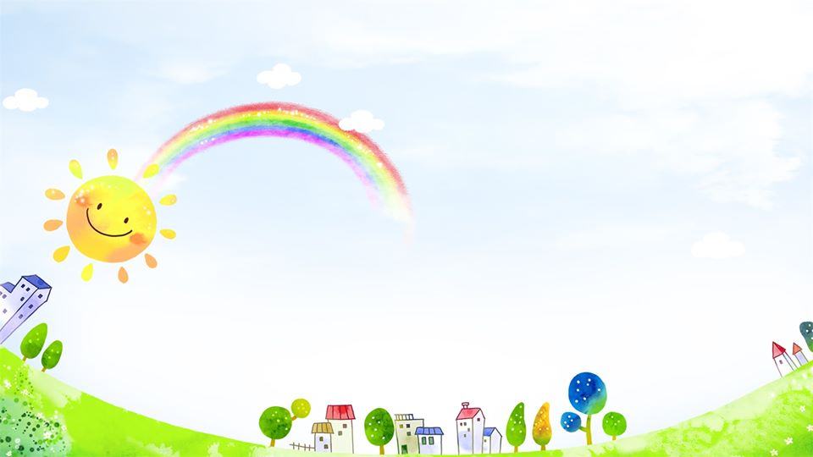
Tuesday, December 8th , 2020
Unit 7: How do you learn English ?
Lesson 2 (1, 2, 3)

Slide 5
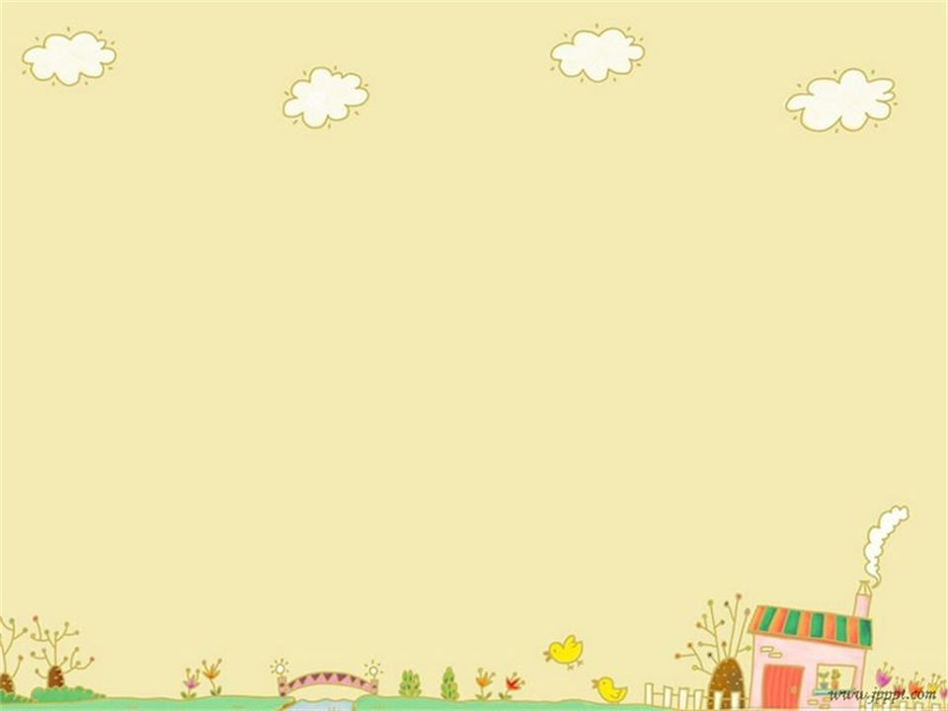
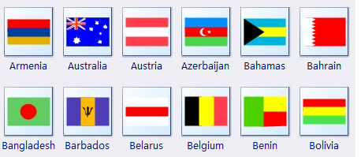
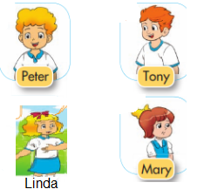



Vocabulary:
foreign
foreign friends:
foreign language:
French:

Slide 6



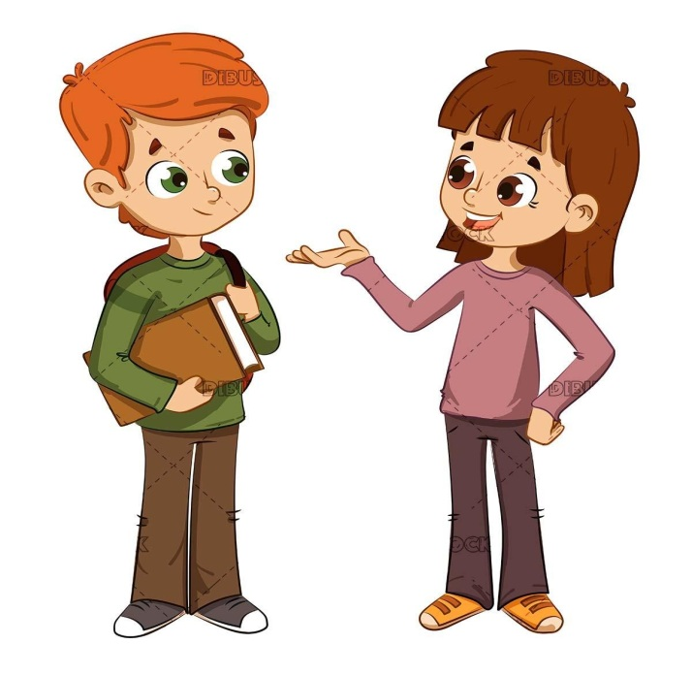
Guessing game
watch cartoons
foreign friends
French
read comic books
talk with friend
foreign language

Slide 7

Guessing game
1
2
3
4

Slide 8
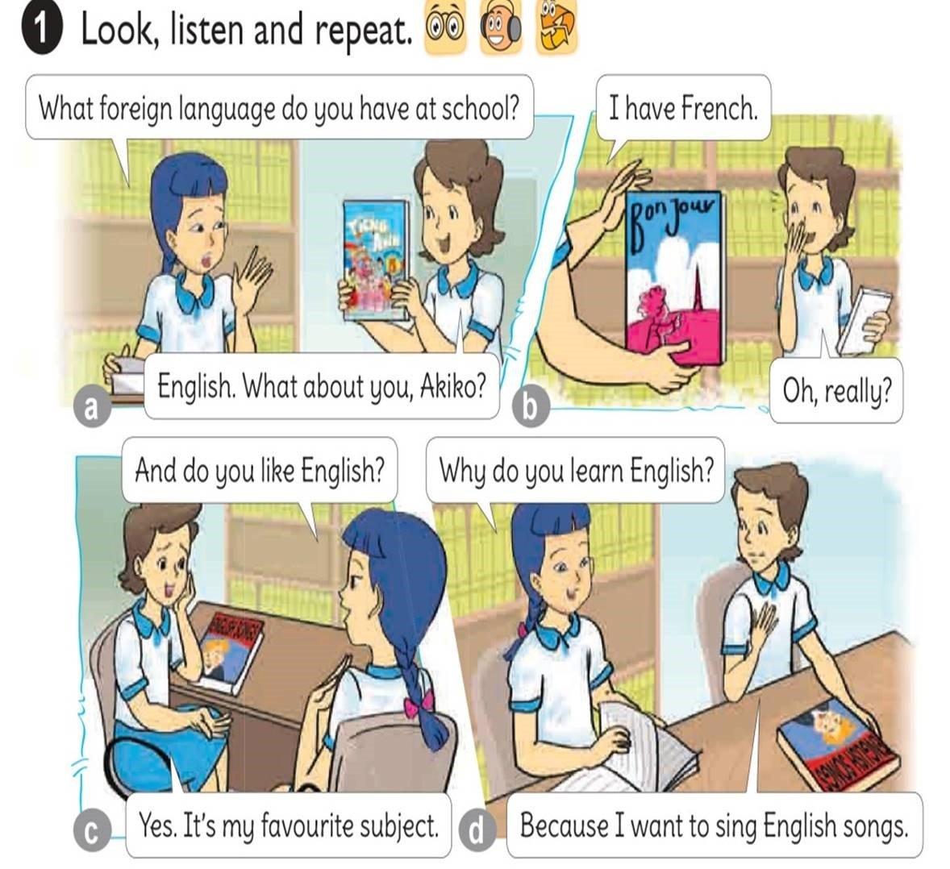




1
2
3
4

Slide 9
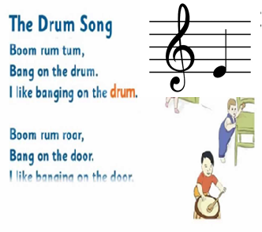
2. Point and say
* Structures
Why do you learn English?
-> Because I want to ________________.
Why do you learn English?
-> Because I want to sing English songs.
E.g:

Slide 10
* Intonation and stress
Why do you learn English?
Because I want to sing English songs.

Slide 11
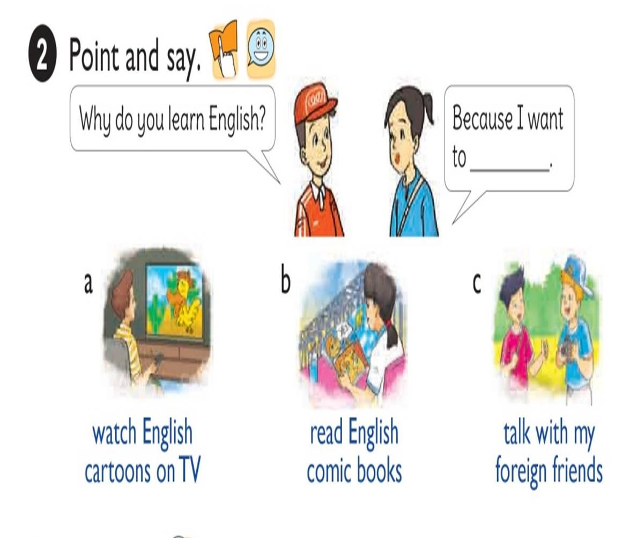

Slide 12
3. Let’s talk
Ask and answer questions about how and why you learn English
How do you learn English?
I________
Why do you learn English?
Because I want to_____

Slide 13

WHO WANTS TO BE A MILLIONAIRE.

Slide 14



Who wants to be milionaire?
1.Why___you learn English?
A. do
A. do
B. drink
C. to do
D. to drink

Slide 15
Who wants to be milionaire?
2. ____I want to sing English songs.
50:50
A. Where
B. Who
C. Because
C. Because
D. A & B are correct.

Slide 16
Who wants to be milionaire?
3. Because I want to______ English comic books.
50:50
A. do
B. go
C. sing
D. read
D. read

Slide 17
Who wants to be milionaire?
5. Because I want to_______ English cartoons on TV.
50:50
B. watch
A. talk
B. watch
C. sing
D. do

Slide 18

Tuesday, December 8th , 2020
Unit 7:
How do you Learn English ?
Lesson 2 (1, 2, 3)
1. Look, listen and repeat.
* Vocabulary
- foreign : nước ngoài
- foreign friends : bạn người nước ngoài
- foreign language: tiếng nước ngoài
- French: tiếng Pháp
2. Point and say.
* Structures
Why do you learn English?
Because I want to ………………..
3. Let’s talk.
- Ask and answer questions about how and why you learn
English .

Slide 19
Home-link
Write new words and structures. Then learn them by heart.
Prepare for lesson 2 part 4,5,6. page 49.

Slide 20

GOODBYE!
THANKS FOR YOUR ATTENTION!

